Slide 1
Smart Home System

Slide 2
Contents
Problems
Solution of Problems
Choices For System Communication Used
Bluetooth Low Energy
Reasons of Choices
Diagrams (Use Case, Requirement)
Implementation and Hardware

Slide 3
Problem Statement
Switches hard to access
Less convenient especially for the elderly (physical declines/disabilities)
Careless or human mistakes and forgetfulness
Not energy and cost efficient

Slide 4
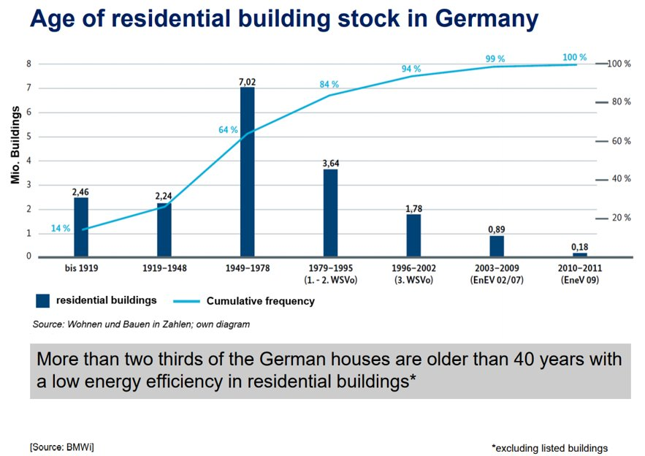
GRAPH SHOWING RESIDENTIAL BUILDING STOCK IN GERMANY

Slide 5
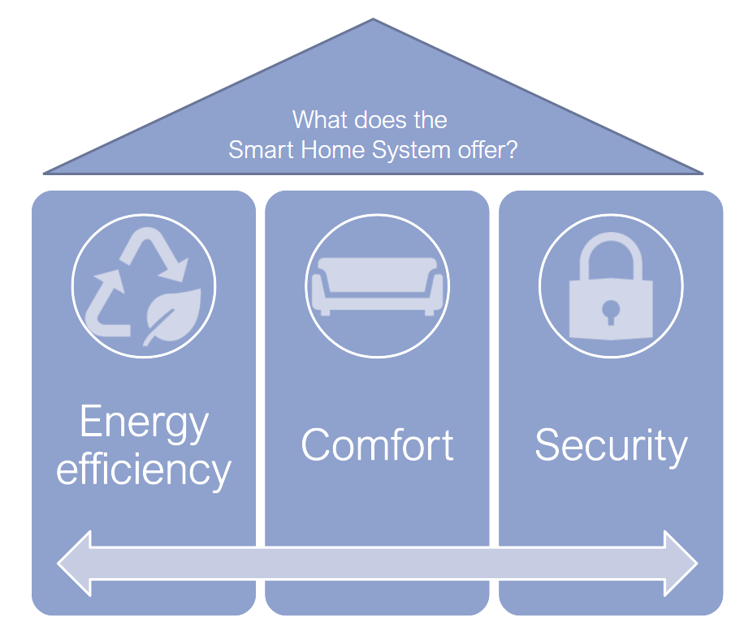
Solution?
Make life easier and more comfortable
Systems in the house controllable with a single touch of a phone
Smart Lamp
All can be realised by having a smart home system!

Slide 6
Implementation of Smart Light

Slide 7
Choices For System Communication Used
Classic Bluetooth
Wifi
Zigbee
Bluetooth Low Energy (BLE)

Slide 8
BlueTooth low energy

Slide 9
Backround Information
Developed by Bluetooth Special Interest Group (Bluetooth SIG) in December 2009
New technology complementing classic bluetooth
Considered a different technology
Different design goals and market segments
Typical applications includes smart health wearables, smart tags for proximity and more

Slide 10
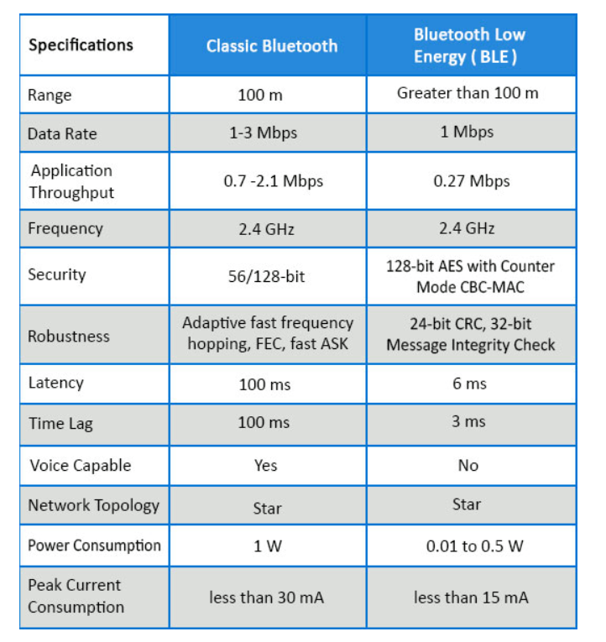
Classic Bluetooth VS BLE

Slide 11
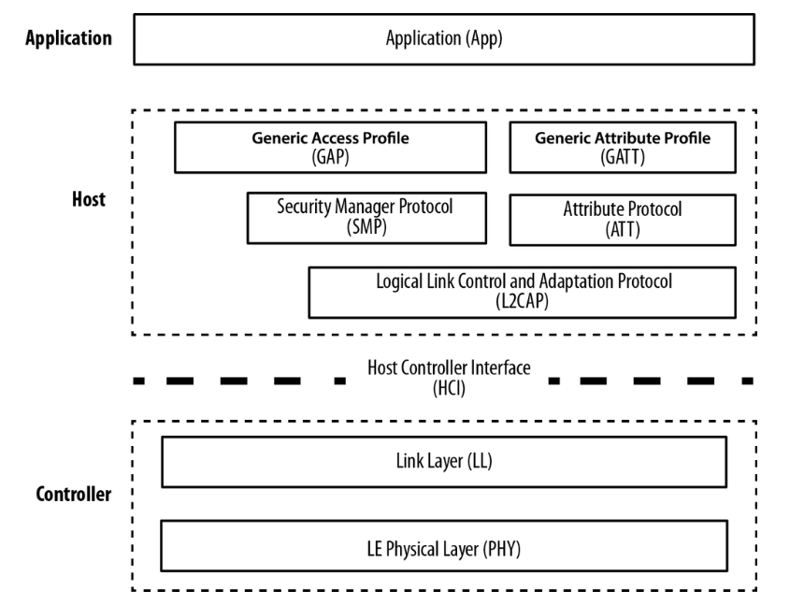
BLE Architecture
Physical layer
Operates in ISM band 2.4GHz in 40 channels
Critical part is GAP and GATT

Slide 12
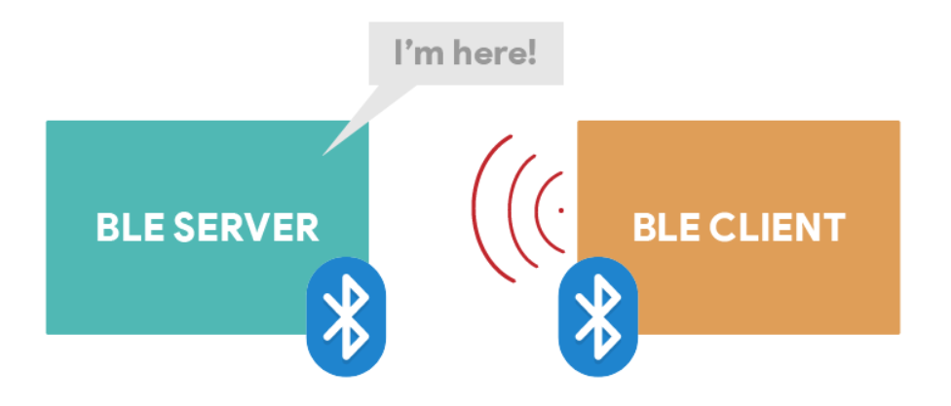
GAP
Generic Access Profile
Server advertises its existence
Clients scans for devices and establishes a connection
Point-to-point communication

Slide 13
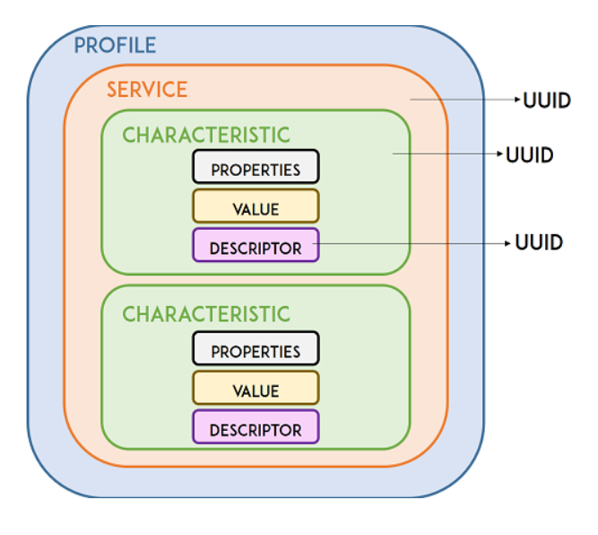
Characteristics and Services
GATT
Generic Attribute Profile
Profile is collection of services
Service is collection of related information
Characteristics is where actual data is stored
Descriptor is the metadata about the data

Slide 14
Reasons Behind It: Why We Chose BLE?
Offers very low power consumption - battery life can be very long
Cheaper cost
Suitable range
Less Complex - does not need to exchange large amounts of data exchange

Slide 15
Our approach

Slide 16
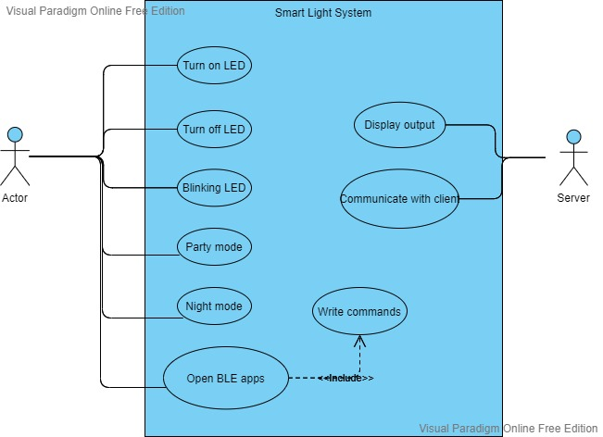
Use Case Diagram

Slide 17
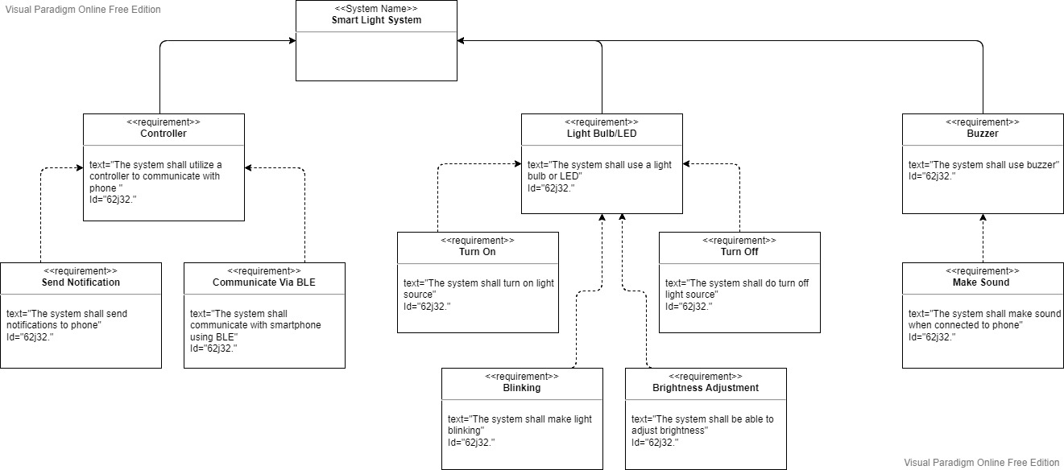
Requirement Diagram

Slide 18
Hardware Used
ESP32
LED
Breadboard
Mobile Phone (App)
Male/Female Wires

Slide 19
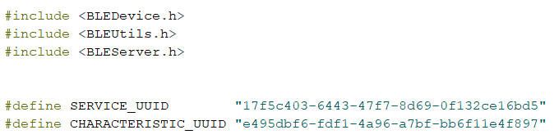
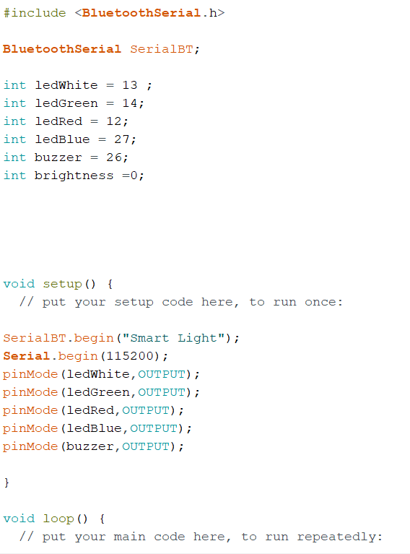
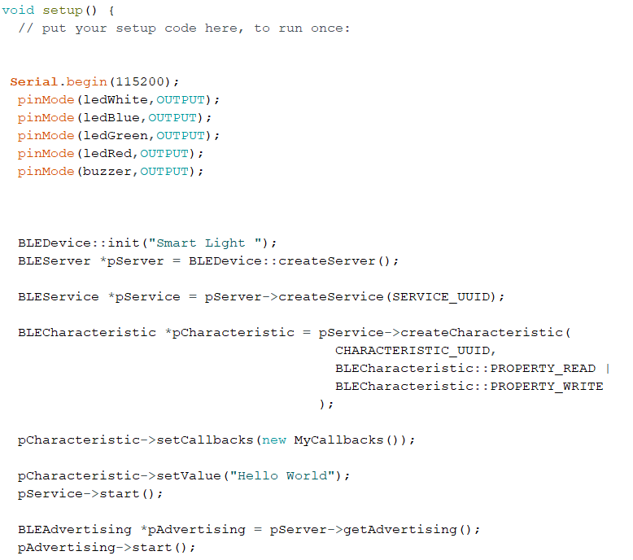
Coding In BLE VS Classic Bluetooth

Slide 20
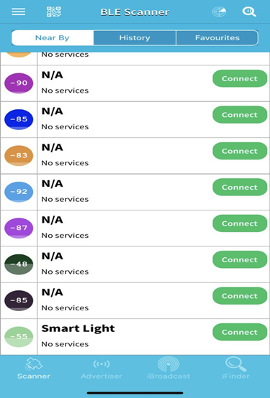
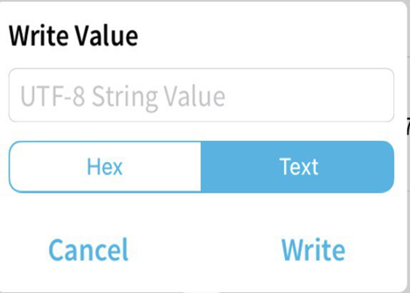
BLE APPS

Slide 21
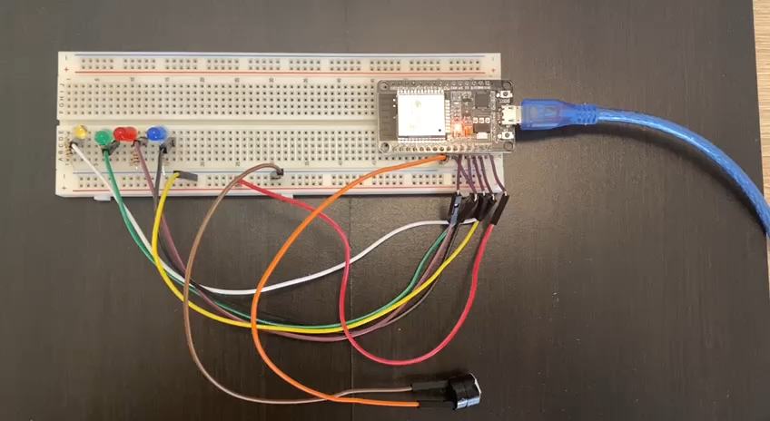
Project Result Simulation

Slide 22
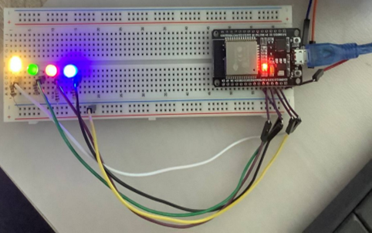
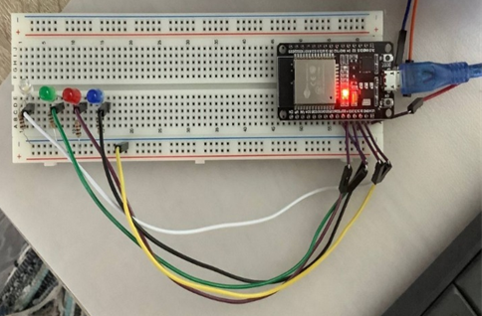
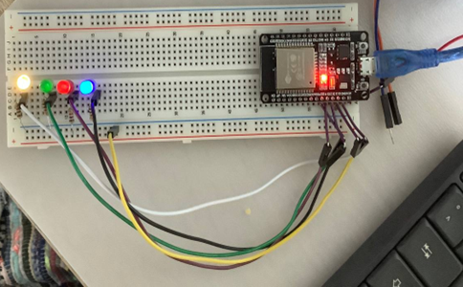

Slide 23
THANK YOU FOR YOUR ATTENTION
ANY QUESTIONS?

